Slide 1
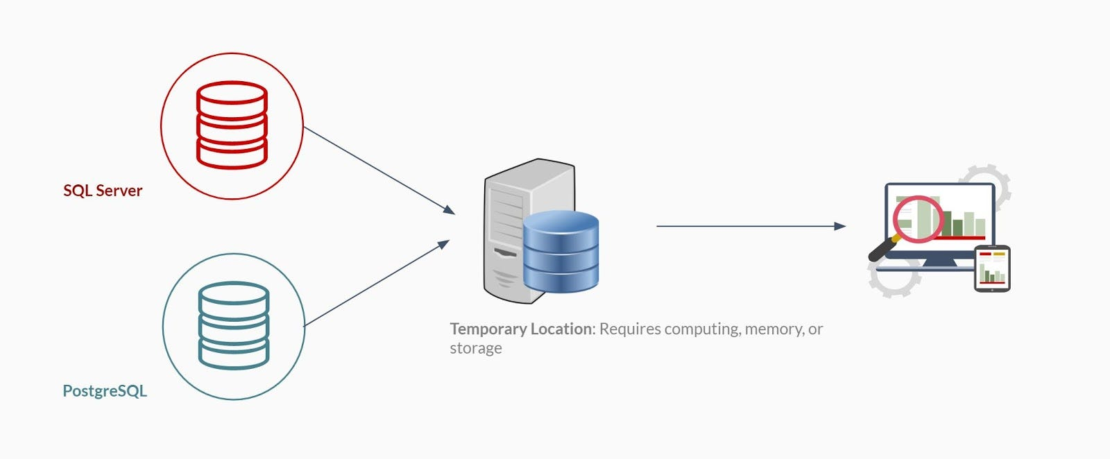
Combining multiple data sources
Combining data from multiple sources involves unifying data from various origins to create a single, comprehensive view. This process aims to provide a coherent and accurate representation, often referred to as a “single point of truth.”

Slide 2
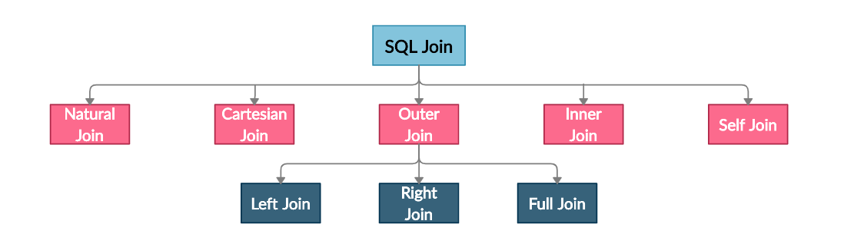
Join types
There are different types of join in SQL

Slide 3
what is Data Blending
Data Blending is used to connect data from multiple data source.
Blending requires two or more distinct data sources , listed independently in the data pane.
Data blending works similarly to a left join
Limitations of data blending
There are some data blending limitations around non-additive aggregates, such as count, median and ROWSQLAGG
Blending data source can not published as a unit.
If you are blending a cube data source ,it must be the primary data source

Slide 4
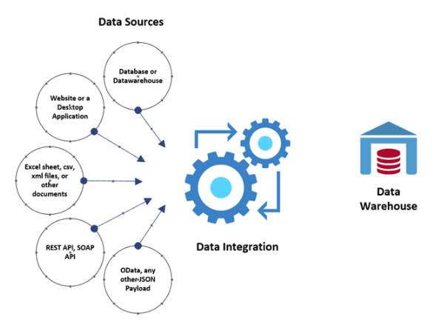
Techniques for integrating and blending data from different sources.

